Slide 1
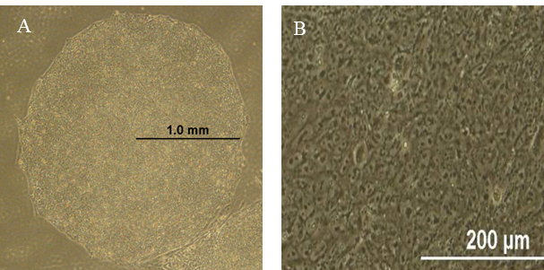
Figure1

Slide 2
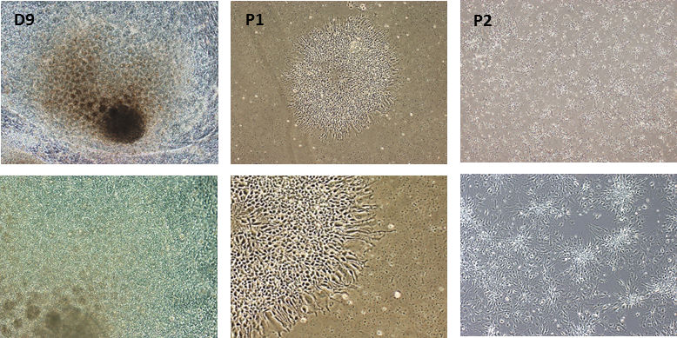
Figure 2
A
Day 0
Noggin(250 µM) , A83 (2 µM), CHIR (3 µM),
Dorsomorphin (5 µM)
Day 9-12
bFGF (40ng/ml)
Induction of Ectoderm &
appearance of Rosette structures
Stable Proliferation

Slide 3
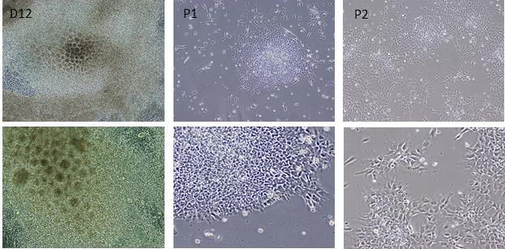
Figure 3
A
Day 0
Noggin(250 µM) , SIS3(0.5 µM), CHIR (3 µM),
Dorsomorphin (5 µM)
Day 9-12
bFGF (40ng/ml)
Induction of Ectoderm &
appearance of Rosette structures
Stable Proliferation

Slide 4
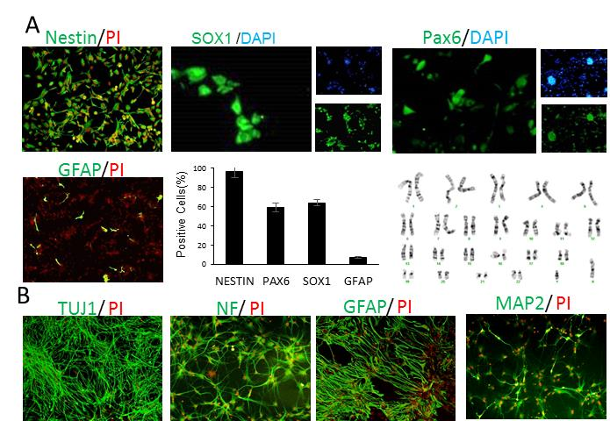
Figure 4:

Slide 5
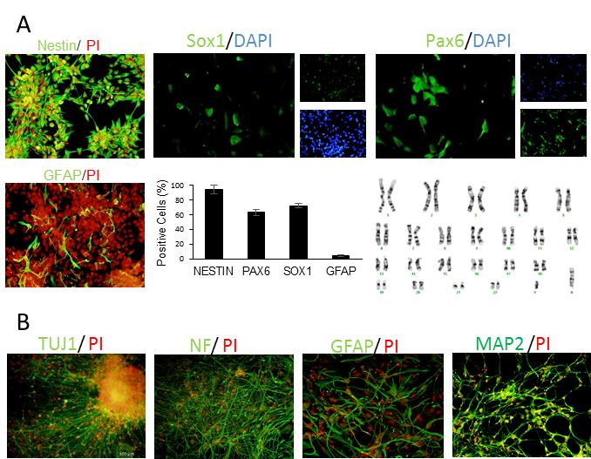
Figure 5

Slide 6
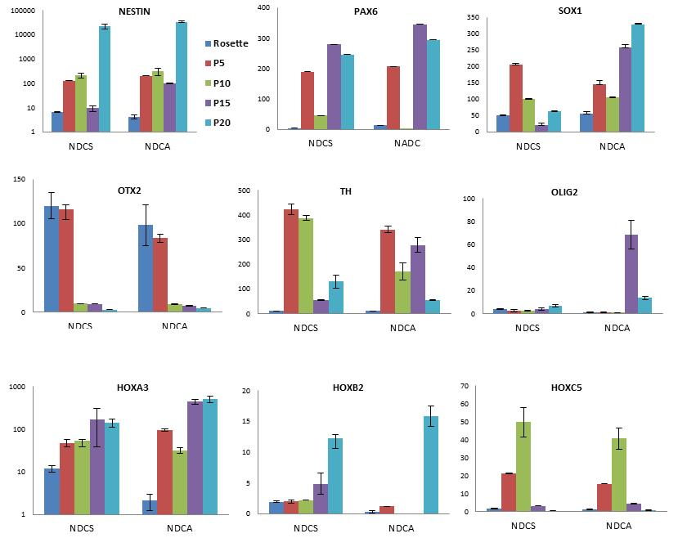
Figure 6

Slide 7
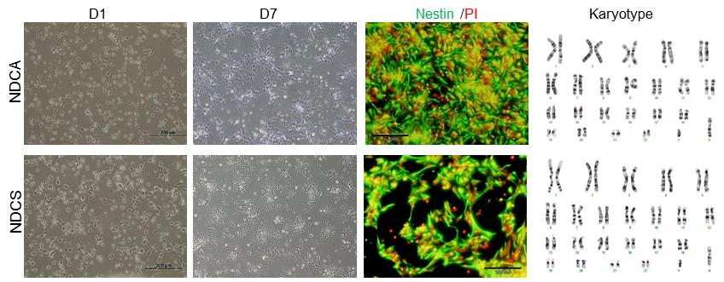
Figure 7

Slide 8
Supplementary Table 1. Antibody used in this study.
Source | Dilution | Clonality | Species | Antibody name
Primary Ab
Chemicon, MAB5326 | 1:100 | Monoclonal | Mouse | NESTIN
Santa Cruz, CA, USA, 11357 | 1:200 | Polyclonal | Rabbit | PAX-6 (H-295)
Abcam, Cambridge, UK, 22572 | 1:1000 | Polyclonal | Rabbit | SOX1
Sigma-Aldrich, T8660 | 1:250 | Monoclonal | Mouse | β-TUBLIN III
Sigma-Aldrich, G3893 | 1:200 | Monoclonal | Mouse | GLIAL FIBRILLARY ACIDIC PROTEIN (GFAP)
Sigma-Aldrich, N0142 | 1:200 | Monoclonal | Mouse | NEUROFIBRILARY FIBROBLAST (NF-H)
Secondary Ab
Chemicon, AP308F | 1:200 |  |  | FITC anti-mouse IgG
Sigma-Aldrich, F1262 | 1:200 |  |  | FITC anti-rabbit IgG
Jackson Immunoresearch Lab., 315-075-003, Hamburg, Germany | 1:100 |  |  | Texas red anti-mouse IgG
Sigma-Aldrich, F9259 | 1:100 |  |  | FITC anti-mouse IgM

Slide 9
Supplementary Table 2. Primers used in this study.
Genes | Primer sequences (5'-3') | Size (bp) | Annealing Temp. (°C)
GAPDH | F: 5’ CTC ATT TCC TGG TAT GAC AAC GA 3’ R: 5’ CTT CCT CTT GTG CTC TTG CT 3’ | 121 | 60
NESTIN | F: 5' CTCCAGAAACTCAAGCACC 3' R: 5' TCCTGATTCTCCTCTTCCA 3' | 144 | 60
SOX1 | F: 5' GTG TAC CCT GGA GTT TCT G 3' R: 5' TAG TCT GTG CCT CTA AGG TG 3' | 200 | 60
PAX6 | F: 5' CGGTTTCCTCCTTCACAT 3' R: 5' ATCATAACTCCGCCCATT 3' | 196 | 60
OTX2 | F:5' CTC TGA ACC TGT CCA CCC 3' R:5' AGC AAG TCC ATA CCC GAA 3' | 147 | 60
TH | F: 5' CTG TGG CCT TTG AGG AGA AG 3‘ R: 5' ATG GTG GAT TTT GGC TTC AA 3' | 128 | 60
HOXA1 | F: 5' AGT GCT GGA GCG AAG AAG AG 3‘ R: 5' TCT CGC CAG TTC ATC TTT CA 3' | 148 | 60
HOXA3 | F: 5' TATTCCTCTGCCCTGGACAC 3‘ R: 5' GGCAAAGTCTGGGAAACTCA 3' | 79 | 60
HOXB2 | F:5' GCC ACG TCT CCT TCT C 3' R:5' CTT CTC CAG TTC CAG CAG 3' | 127 | 60
HOXC5 | F:5' TCA AAG AGT CAC AAA TCA CC 3' R:5' TCC ATA GTT CCC ACA AGT T 3' | 104 | 60

